Slide 1
Black Box Testing
Balázs Cservenák – Software Test Automation Engineer - <Epam>
Email: Balazs_Cservenak@epam.com
2024

Slide 2

Agenda
01
Black-box testing in general
02
Equivalence Partitioning
03
Boundary Value Analysis
04
State transition testing
05
Positive and Negative test cases
06
Decision tables
07
Questions

Slide 3
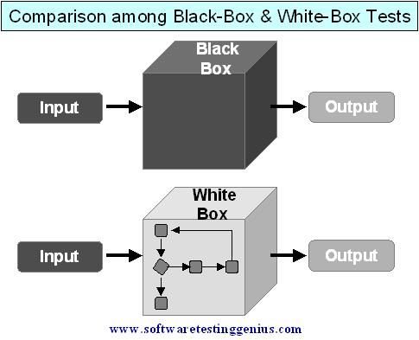
BLACK BOX TESTING IN GENERAL
Black box testing techniques
The internal structure of the test object is not necessary or available
Test cases are derived from the software requirements
White box testing techniques
Program code is used for test design
Internal flow is analyzed

Slide 4
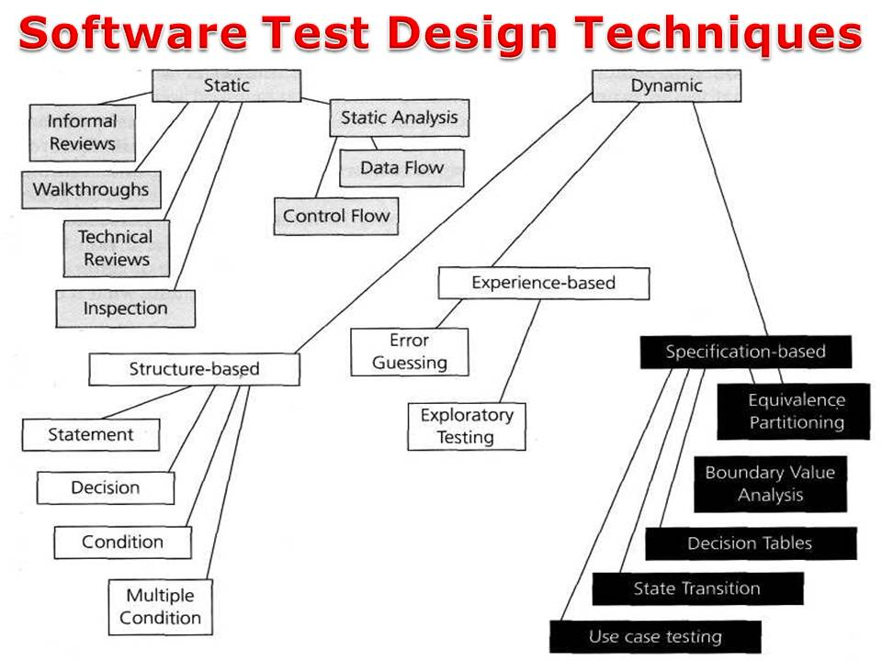
BLACK BOX TESTING IN GENERAL

Slide 5
Equivalence Class Partitioning/Boundary Value Analysis
The domain of possible input data for each input data element is divided into equivalence classes
An equivalence class is a set of data values that the tester assumes are processed in the same way by the test object
Besides equivalence classes for correct input, those for incorrect input values must be tested as well
Valid/Invalid partitions need to be tested as well
The Equivalence Class Partitioning is used with the Boundary Value Analysis
Boundary value analysis delivers a very reasonable addition to the test a reasonable extension cases that have been identified by equivalence class partitioning
One and two boundary values are commonly used

Slide 6
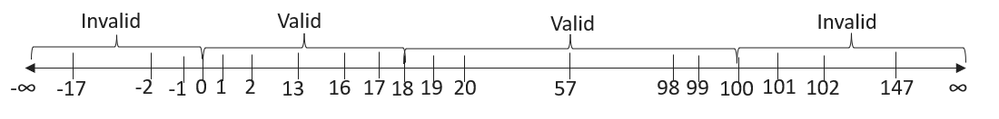
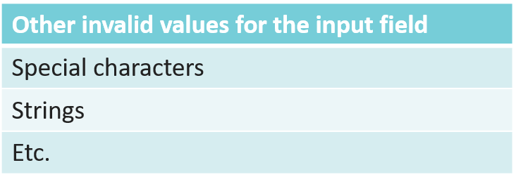
Equivalence Class Partitioning/Boundary Value Analysis
There is an input field where the users can set age between 0 and 100 (integer only)
Adult people can have insurance
People who are more than 100 years old can not have insurance
A „Confirmation” popup is displayed if the person is not adult
Boundaries:

Slide 7
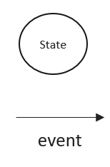
State transition testing
In many systems not only the current input but also the history of execution or events influences the system behaviour
The output can be different for the same input, depending on the history of execution
During the execution the system starts from an initial state and can comes into different states until reaches the final state
State transition diagram is the basis of the test design
parts of the state transition model
States that the system might get
Events/conditions which trigger the state changes

Slide 8
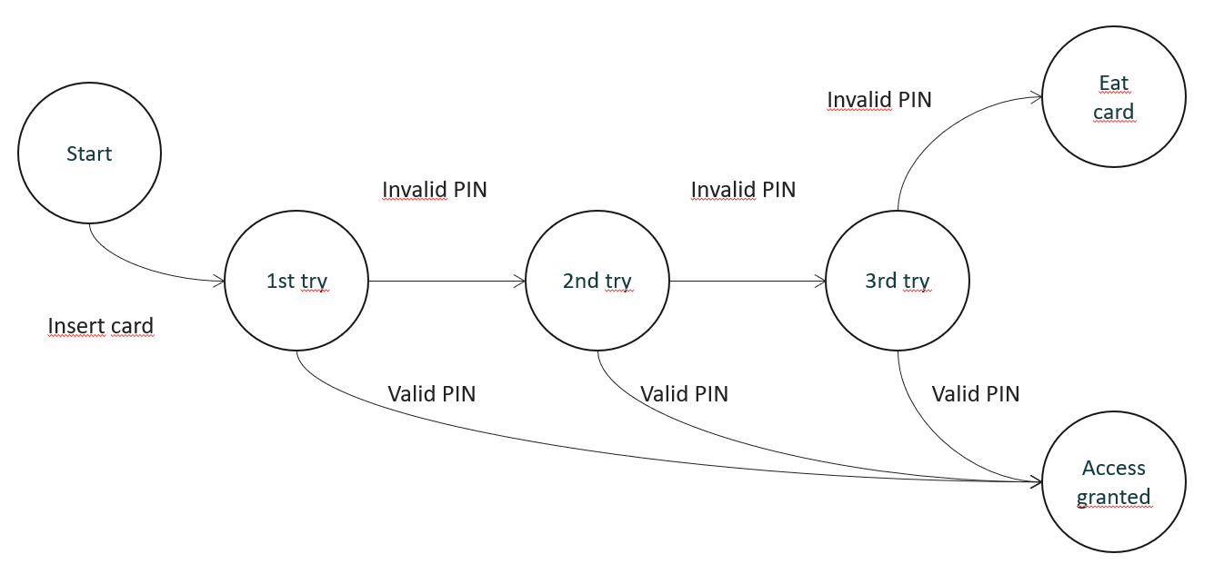
State transition testing
ATM testing – Identifying States and events
Start state: before inserting the card
End states:
  The user accesses his/her account
  ATM eats the card
In-between states:
  1st try for entering the PIN
  2nd try for entering the PIN
  3rd try for entering the PIN
Events:
  Inserting the card
  Entering invalid PIN
  Entering valid PIN

Slide 9
State transition testing
ATM testing – State transition table
States:
S1) Start state
S2) 1st try
S3) 2nd try
S4) 3rd try
S5) Access account
S6) Eat card
S6
S1
S2
S3
S4
S5
 | Insert card | Valid PIN | Invalid PIN
S1) Start state | S2 | - | -
S2) 1st try | - | S5 | S3
S3) 2nd try | - | S5 | S4
S4) 3rd try | - | S5 | S6
S5) Access account | - | - | -
S6) Eat card | S1 (for a new card) | - | -

Slide 10
Test case, Positive and Negative test cases
What is a test case?
Set of actions executed to verify a particular feature or functionality of the software application
It consists of test data, precondition, steps, actual result, expected result
Positive test cases
Valid data as input
Application behaves as expected with positive inputs
Negative test cases
Invalid data as input
Application can handle invalid data or unexpected user behavior
Helps to improve the quality and find weak points

Slide 11
State transition testing
ATM testing – State transition table
States:
S1) Start state
S2) 1st try
S3) 2nd try
S4) 3rd try
S5) Access account
S6) Eat card
Positive cases | Negative cases
S1 -> S2 -> S3 -> S4 -> S5 | Entering PIN while in S5?
S1 -> S2 -> S3 -> S4 -> S6
S1 -> S2 -> S5
S1 -> S2 -> S3 -> S5

Slide 12
Decision tables
Definition
A Decision Table is a tabular representation of inputs versus rules/cases/test conditions. It is a very effective tool used for both complex software testing and requirements management. Decision table helps to check all possible combinations of conditions for testing and testers can also identify missed conditions easily.
Number of test cases
Count the possible values for each condition and multiply these together to determine how many unique combinations of conditions are present.
How to use decision tables?
Define which conditions are to be included in the table
Determine the number of columns based on the conditions
Fill the table cells with True/False values (make sure to proceed systematically to avoid excluding a combination)
Fill the end results
Simplify table if possible

Slide 13
Decision tables - Example - Calculating discount
Define which conditions are to be included in the table:
1. New customers get a 15% discount
2. Loyalty card holders get a 10% discount
3. Coupons provide a 20% discount (but cannot be used with the 'new customer' discount)
Conditions
New customer
Has loyalty card
Has coupon
Discount amount

Slide 14
Decision tables - Example - Calculating discount
Determine the number of columns based on the conditions:
1. New customers get a 15% discount (Yes/No)
2. Loyalty card holders get a 10% discount (Yes/No)
3. Coupons provide a 20% discount (but cannot be used with the 'new customer' discount) (Yes/No)
Conditions | Case 1 | Case 2 | Case 3 | Case 4 | Case 5 | Case 6 | Case 7 | Case 8
New customer
Has loyalty card
Has coupon
Discount amount

Slide 15
Decision tables - Example - Calculating discount
Fill the table cells with True/False values (make sure to proceed systematically to avoid excluding a combination):
1. New customers get a 15% discount
2. Loyalty card holders get a 10% discount
3. Coupons provide a 20% discount (but cannot be used with the 'new customer' discount)
Conditions | Case 1 | Case 2 | Case 3 | Case 4 | Case 5 | Case 6 | Case 7 | Case 8
New customer | T | T | T | T | F | F | F | F
Has loyalty card
Has coupon
Discount amount

Slide 16
Decision tables - Example - Calculating discount
Fill the table cells with True/False values (make sure to proceed systematically to avoid excluding a combination):
1. New customers get a 15% discount
2. Loyalty card holders get a 10% discount
3. Coupons provide a 20% discount (but cannot be used with the 'new customer' discount)
Conditions | Case 1 | Case 2 | Case 3 | Case 4 | Case 5 | Case 6 | Case 7 | Case 8
New customer | T | T | T | T | F | F | F | F
Has loyalty card | T | T | F | F | T | T | F | F
Has coupon
Discount amount

Slide 17
Decision tables - Example - Calculating discount
Fill the table cells with True/False values (make sure to proceed systematically to avoid excluding a combination):
1. New customers get a 15% discount
2. Loyalty card holders get a 10% discount
3. Coupons provide a 20% discount (but cannot be used with the 'new customer' discount)
Conditions | Case 1 | Case 2 | Case 3 | Case 4 | Case 5 | Case 6 | Case 7 | Case 8
New customer | T | T | T | T | F | F | F | F
Has loyalty card | T | T | F | F | T | T | F | F
Has coupon | T | F | T | F | T | F | T | F
Discount amount

Slide 18
Decision tables - Example - Calculating discount
Fill the end results:
1. New customers get a 15% discount
2. Loyalty card holders get a 10% discount
3. Coupons provide a 20% discount (but cannot be used with the 'new customer' discount)
Conditions | Case 1 | Case 2 | Case 3 | Case 4 | Case 5 | Case 6 | Case 7 | Case 8
New customer | T | T | T | T | F | F | F | F
Has loyalty card | T | T | F | F | T | T | F | F
Has coupon | T | F | T | F | T | F | T | F
Discount amount | X | X | 20 | 15 | 30 | 10 | 20 | 0

Slide 19
Decision tables - Example - Calculating discount
Simplify table if possible:
1. New customers get a 15% discount
2. Loyalty card holders get a 10% discount
3. Coupons provide a 20% discount (but cannot be used with the 'new customer' discount)
Conditions | Case 1 | Case 2 | Case 3 | Case 4 | Case 5 | Case 6 | Case 7 | Case 8
New customer | T | T | T | T | F | F | F | F
Has loyalty card | T | T | F | F | T | T | F | F
Has coupon | X | X | T | F | T | F | T | F
Discount amount | X | X | 20 | 15 | 30 | 10 | 20 | 0

Slide 20
Questions?

Slide 21
Thank you!
For more information, contact me on this email:
Balazs_Cservenak@epam.com

